Slide 1
CPU Scheduling Algorithms
Alhaji Nyallay
Daniel Ladner
Wei Wu

Slide 2
Overview
Introduction
Purpose of Scheduling Algorithms
Scheduling Algorithms Implementation in C++
Comparison Metrics
Input Jobs
CPU Utilization
Average Turnaround
Average Wait Time
Demonstration

Slide 3
Introduction
In multiprogramming systems, when there is more than one ready process, the operating system must decide which one to activate.
The decision is made by the part of the operating system called the scheduler, using a scheduling algorithm.
The scheduler is concerned with deciding policy, not providing a mechanism

Slide 4
Purpose of Scheduling Algorithms
Manage CPU resources
Avoid ‘Deadlock’
Minimize Turnaround time
Prevent Starvation

Slide 5
Implementation in C++ Overview
Fcfs fcfs(contextSwitch);
Sjf sjf(contextSwitch);
while (!jobFile.eof()) {
//run all jobs
toRun = readJob(jobFile);
fcfs.runJob(toRun);
sjf.runJob(toRun);
}

Slide 6
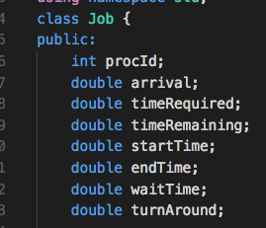
Job Class

Slide 7
Algorithms Summary
First Come First Serve
It is the simplest CPU-scheduling algorithm.
Jobs are allowed to execute until completion.
It is a non-preemptive CPU scheduling algorithm.
Schedules according to arrival times of jobs.

Slide 8
First Come First Serve Implementation
void Fcfs::runJob(Job toRun){...
If toRun is in future: advance time to toRun arrival
Apply context switch
Process Job
Add Job to finished vector
}

Slide 9
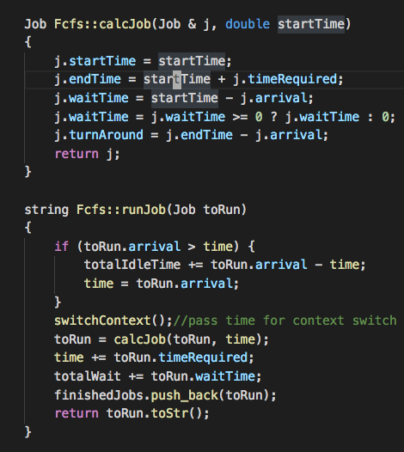
FCFS Code

Slide 10
FCFS Code

Slide 11
Algorithms Summary
Shortest Job Next
The shortest job first algorithm is a priority based scheduling algorithm
This associates with each process the length of the process's next CPU burst.
When CPU is available, it is assigned to the process that has the smallest next CPU burst.
There is preemptive mode in which jobs are schedule according to shortest remaining time.

Slide 12
SJF Implementation
void Sjf::runJob(Job toRun){
If toRun in present or past: add to ready heap and return
while (ready heap is not empty) pop shortest job and run it
Add toRun to ready heap
Advance time to toRun
}

Slide 13
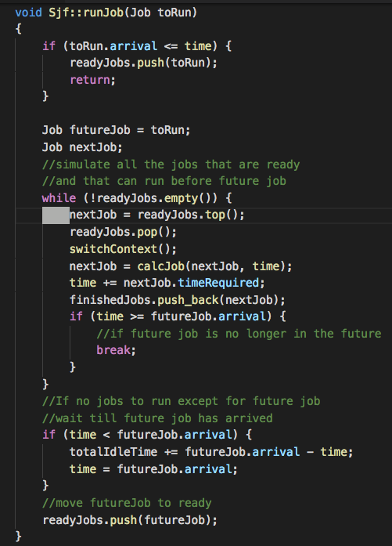
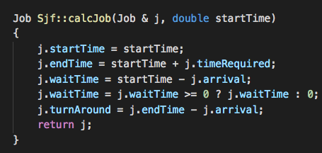
SJF Code

Slide 14
Algorithms Summary
3) Round Robin
Each process is assigned a fixed time in a cyclic way.
It is one of the most commonly used technique in CPU scheduling as a core.
It is preemptive as processes are assigned a CPU only for a fixed slice of time at most.
The disadvantage of it is more overhead of context switching.

Slide 15
Round Robin Implementation
void RoundRobin::runJob(Job toRun){
If toRun in present or past: add to ready queue and return
while(ready queue not empty and time <= toRun.arrival){
Take job from ready queue apply time quantum
If (not job completed) {Add job back to ready queue} else {add toFinished}
}
Advance time to toRun.arrival}

Slide 16
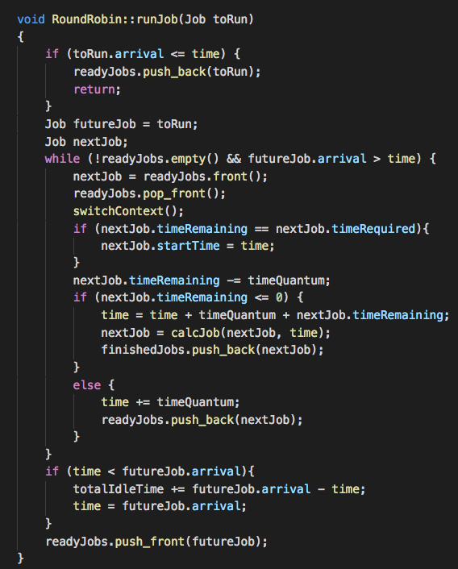
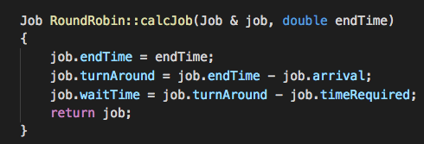
Round Robin Code

Slide 17
Comparison Metrics
CPU utilization:
Percent of time that the CPU is busy executing a process.
Wait time:
The amount of time the process spends in the ready queue waiting for the CPU.
Turn around time:
The interval of time between submission of a process and its completion.

Slide 18
Input Jobs
Size: 10,000 jobs
Time required: normal distribution from 5 to 100 time units
Intervals between jobs: exponential distribution with a mean of 100

Slide 19
Command Line Arguments
./sim [-d] [-a] [algorithm name] input file
Argument -d adds detailed information
Argument -a specifies specific algorithm
Input file specifies file to use (if none specified jobs will be generated)

Slide 20
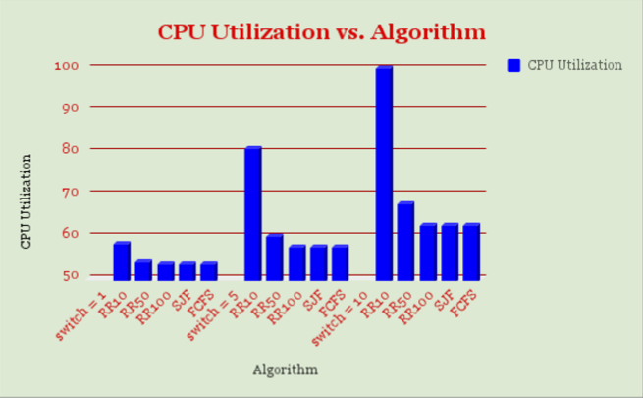
CPU Utilization

Slide 21
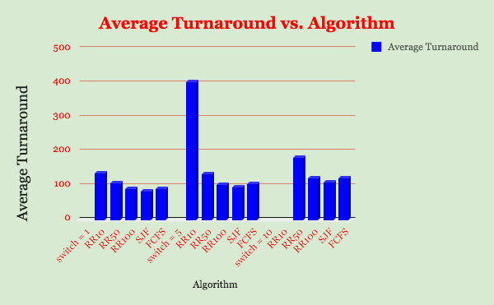
Average Turn
Outlier:
For Context Switch 10:
Round Robin with time quantum 10 had an average turnaround time of: 60104.7

Slide 22
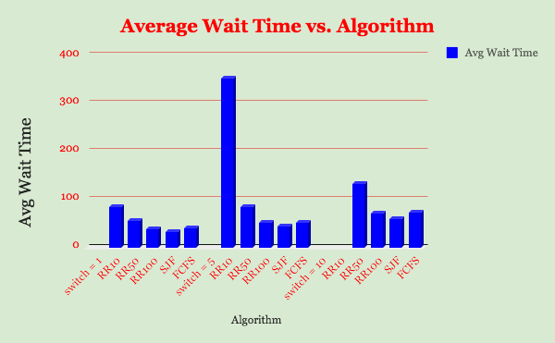
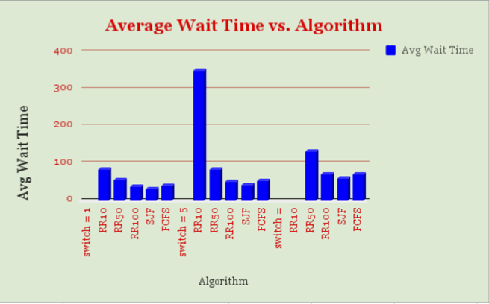
Average Wait Time
For Context Switch 10:
Round Robin with time quantum 10 had average waiting time of: 60053

Slide 23
Conclusion
SJF can save wait time
FCFS is easy to implement
Round Robin has higher CPU utilization
Round Robin has similar throughput
Round Robin will perform significantly worse with high context switch time

Slide 24

THANK YOU!!

